Slide 1


Slide 2
EE 313 Term Project Video Presentation
Kaan Demirkoparan 2442903
Ahmet Akman 2442366
January 24, 2023

Slide 3
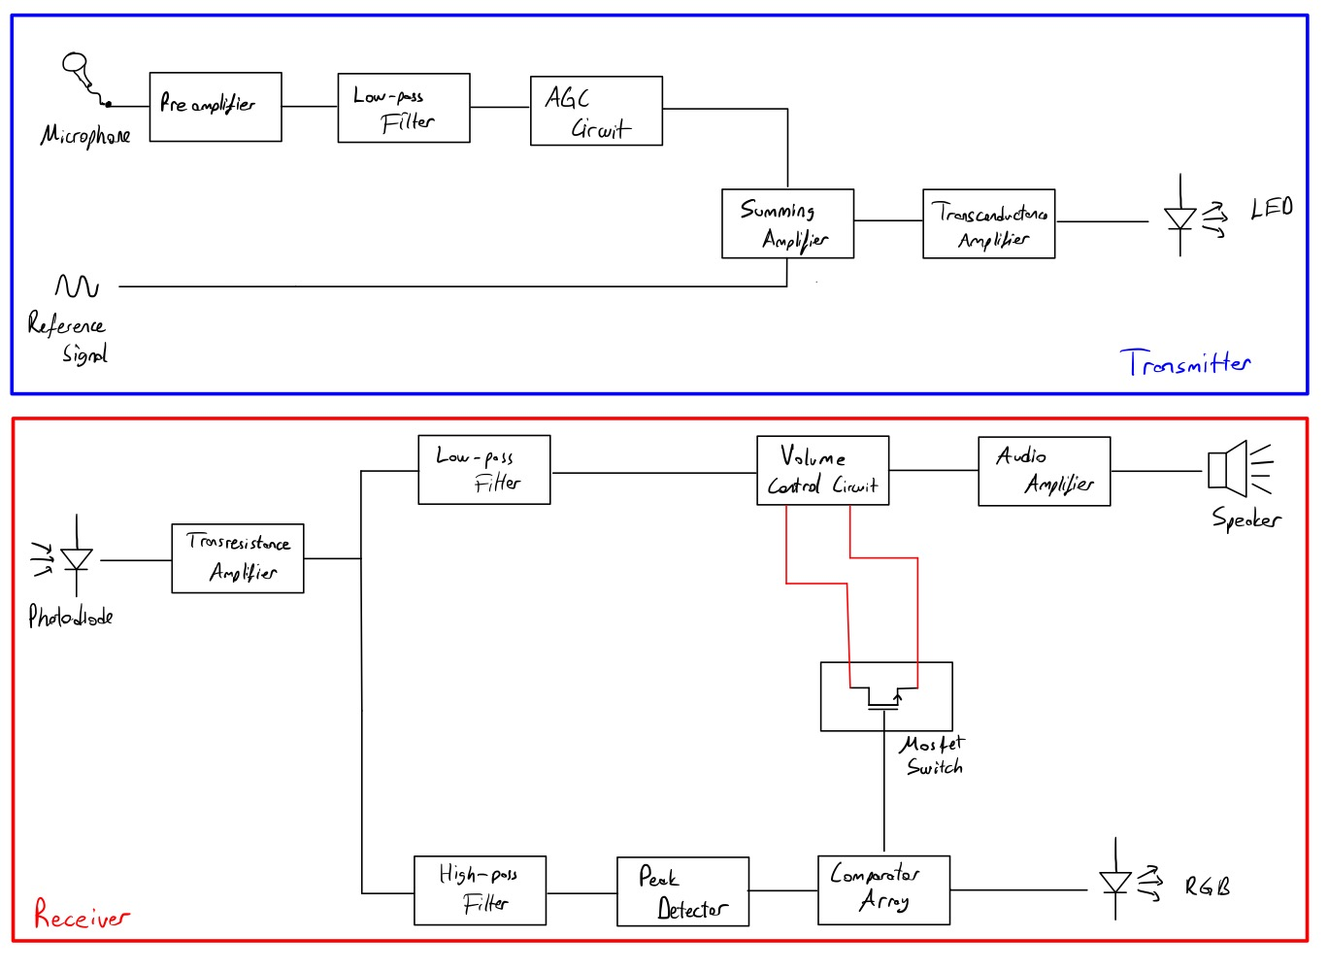
Overall Block Diagram of the Project

Slide 4
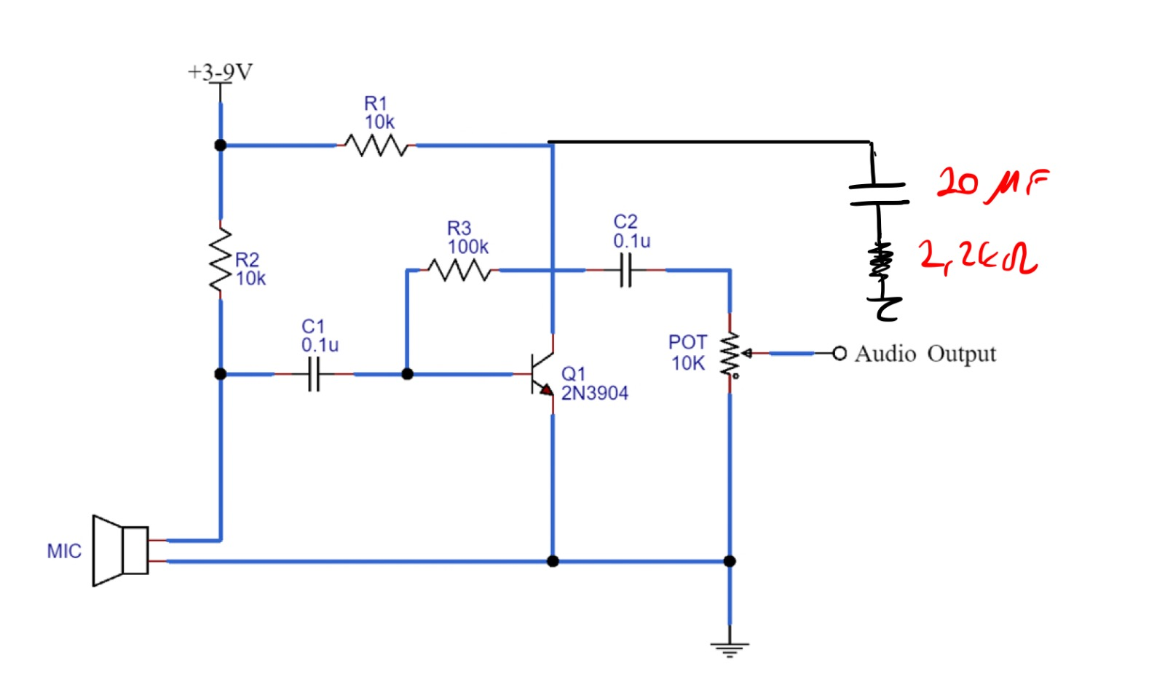
Microphone and Preamplifier Stage

Slide 5
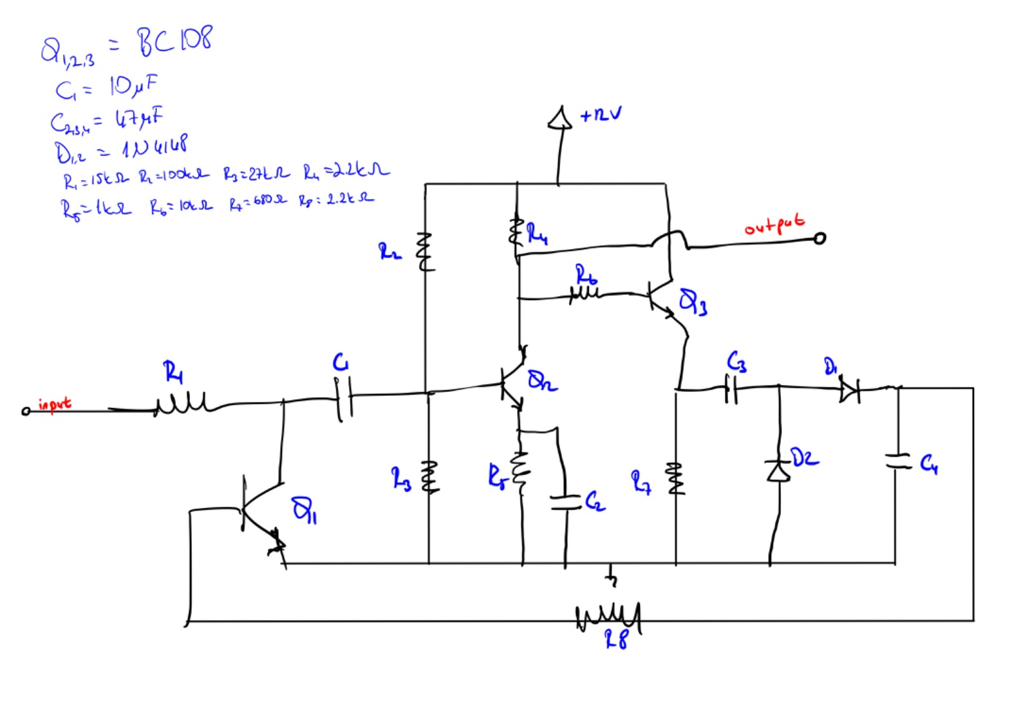
Automatic Gain Control Stage (AGC)

Slide 6
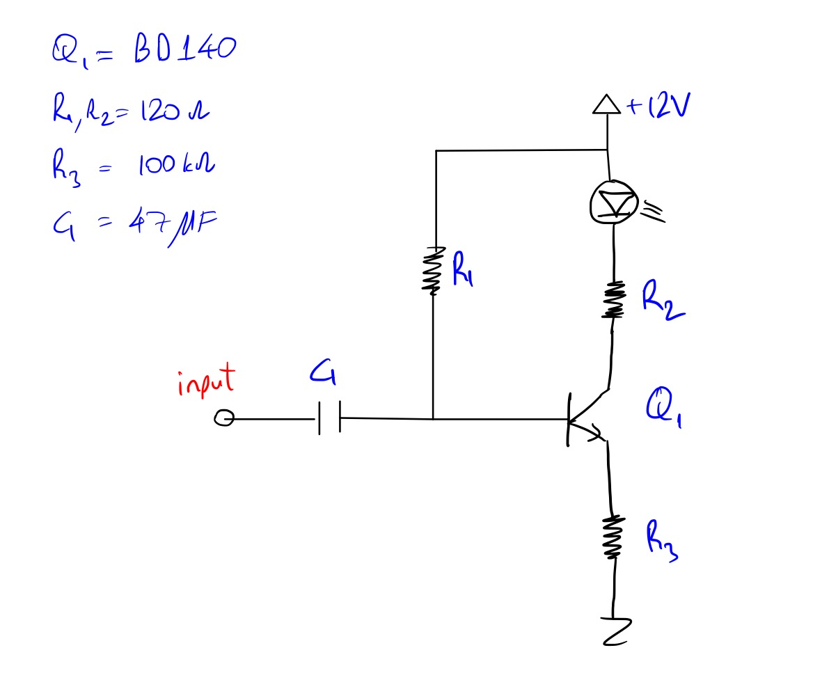
Carrier Signal Sum and IR LED Driver Stage

Slide 7
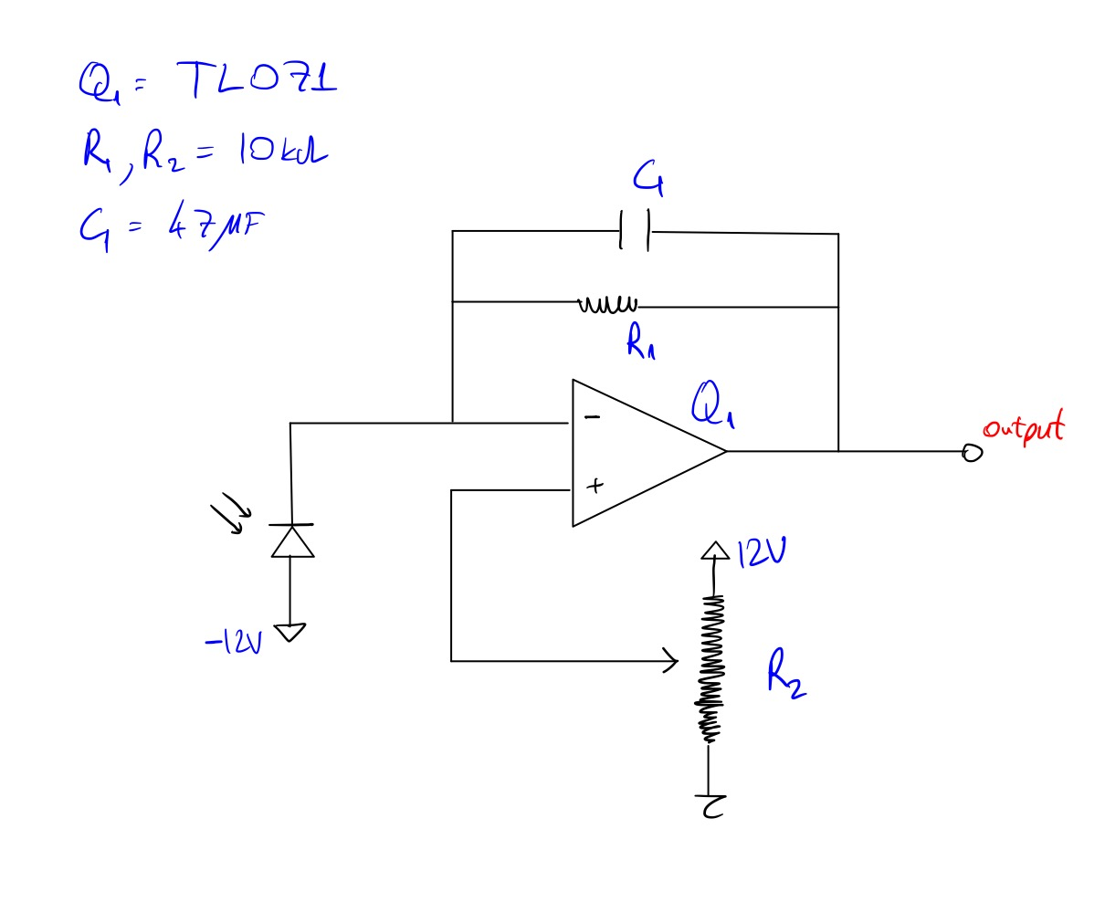
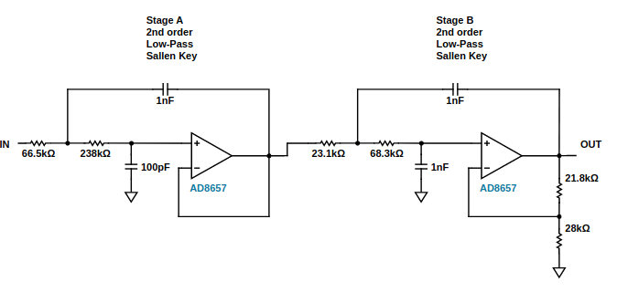
IR LED Receiver and Low Pass Stage

Slide 8
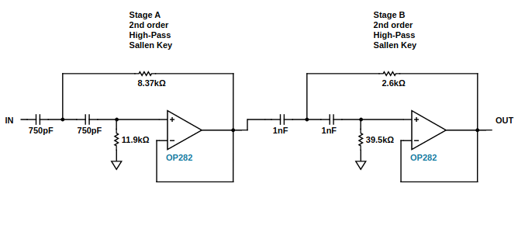
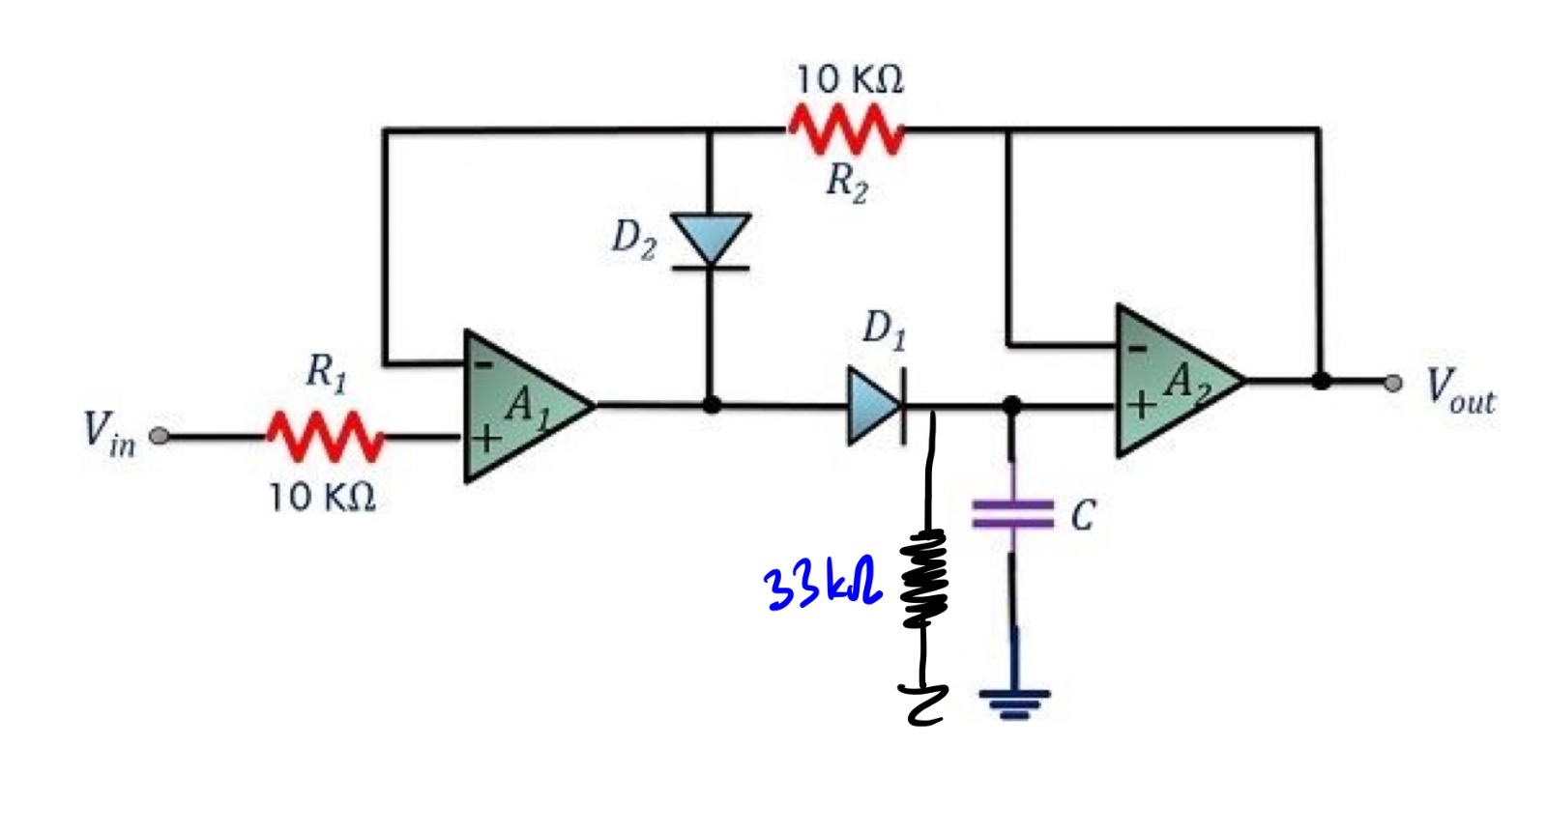
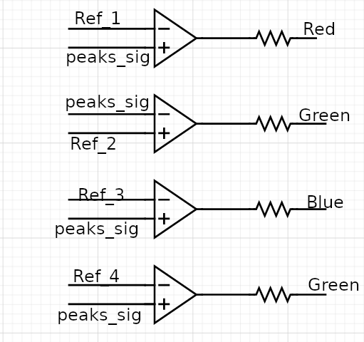
High Pass and Peak Detection, Signal Indication

Slide 9
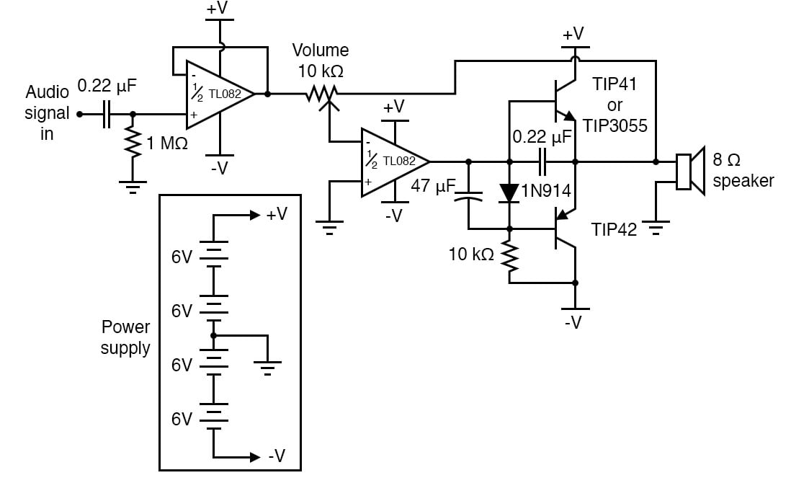
Audio Amplifier Stage
Class B Topology

Slide 10
Conclusion
Design specs are met.
Prototype success.
Demonstration completed in 23rd of January

